Slide 1
Analysis of “County-level Analysis of Perinatal Health Indicators Within a Single Health System Catchment”
By Kay Johnson, Yuze Guo, & Véronique Godoy

Slide 2


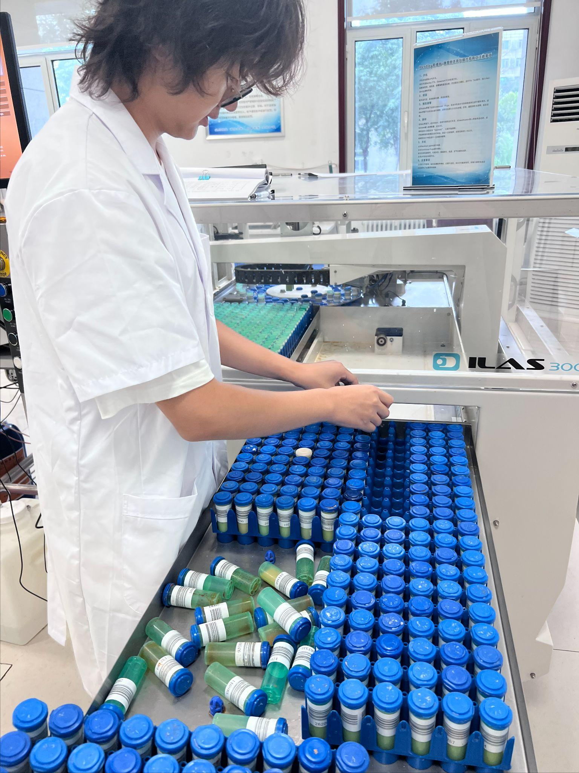

Student Profile: Yuze

Slide 3
Introduction
Adverse perinatal health outcomes are far higher in the United States than in similarly large and wealthy countries.
Perinatal health disparities cause the difference in perinatal health outcomes among the investigated areas.
UFHPCA was defined as all Florida counties where ≥5% of all infants were delivered at Shands Hospital in Alachua County between June 2011 and April 2017.

Slide 4
Background
It is not the clinical care but the non-clinical factors (90%), known as the social determinants of health (SDoH) determine the health outcomes.
Common social determinants: income, unemployment, education, racial or ethnicity, or geography.
Some of the determinants are correlated.
Income status and education level are related to social behaviors.
Maternal education is the strongest factor that influences breastfeeding initiation and during and smoking cessation success.
Low socioeconomic status was associated with a higher risk of smoking at the time of conception and continued smoking during pregnancy.

Slide 5
Study Design & Data Collection
Study Design
County-level analysis of perinatal health indicators in the UF Health Perinatal Catchment Area.
UFHPCA Definition: Florida counties where ≥5% of infants were delivered at UF Health Shands Hospital (June 2011 – April 2017).
Data Sources
UF Health Shands Hospital: Electronic health records.
FloridaHealthCHARTS.gov & County Health Rankings: Socioeconomic and health metrics.
Florida Department of Health: County-level birth data.
Rurality Classification
Based on Florida Statutes 288.0656.

Slide 6
Study Population & Key Variables
Study Population
64,000+ deliveries analyzed across 13 counties.
Approximately one-third of infants resided in rural areas.
Key Variables Analyzed
Maternal Health: Mortality, smoking, breastfeeding initiation.
Healthcare Access: Obstetrician-gynecologist availability, hospital access.
Socioeconomic Factors: Household computing device access.
Analysis focused on comparing rural and non-rural disparities.

Slide 7
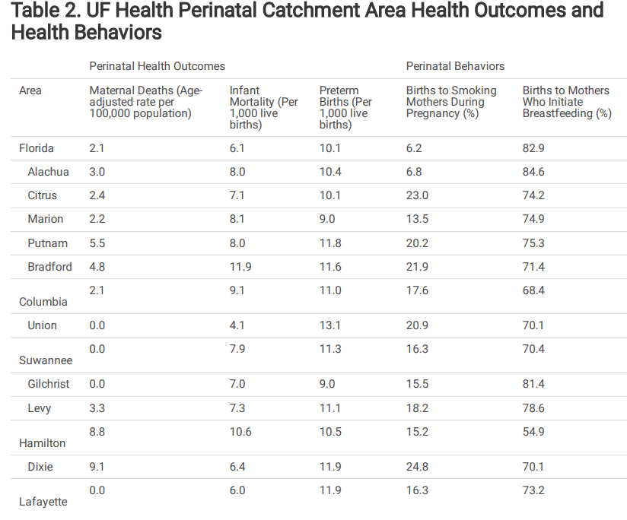
Results
Figure 1: Data Table

Slide 8
Results (Fig. 1 highlights)
The research included 64,000 deliveries from three non-rural and ten rural counties, over a 5 years and 9-month period.
Around 1 in 3 infants resided in a rural county and 7 out 13 counties did not have a licensed obstetrician gynecologist. (Other licensed providers that they lack include: family medicine, obstetrics, and pediatricians).
9 counties reported maternal death rate between 1 and 4 fold higher than the statewide rate.
Infant mortality in 12/13 of the counties reported 6.4-13.1 death per 1,000 live births. (statewide infant mortality rate is 6.1 over 1,000 live births).
preterm birth rates were 9.0-13.1 per 1,000 live births. (statewide rate is 10.1 infants per 1,000 live births).
Maternal smoking rates (6.8%to 24.8%) were above statewide rate (6.2%) for all counties

Slide 9
Discussion of Results
Rural counties were characterized with higher levels of smoking during pregnancy, increased childhood poverty rates, lower levels of breastfeeding initiation, and more limited access to computing devices.
North Central Florida (rural and non-rural), have higher maternal and infant mortality and higher levels of smoking during pregnancy and childhood poverty and lower levels of breastfeeding, than the statewide rate.

Slide 10
Conclusion
There is a need to address the impact of SDoH on perinatal health. Such as expanding health care access to rural counties, and improving healthcare access through telemedicine. (More licensed physicians are needed!)
Proving a better environment for families and parents through policies and programs to improve perinatal outcomes.

Slide 11
Implications
Highlighting Disparities: Significant differences in perinatal health outcomes and healthcare access between rural and non-rural counties.
Maternal Health: Elevated maternal mortality and smoking rates in certain counties, pointing to potential areas for targeted intervention.
Healthcare Access: Lack of obstetricians/gynecologists in several counties, emphasizing the need for improved healthcare provider distribution in rural areas.
Public Health Initiatives: Findings suggest the need for enhanced support programs focusing on maternal health, smoking cessation, and breastfeeding promotion, especially in underserved regions.
Policy Impact: Data could inform public health policy decisions to address healthcare access and maternal health inequalities in Florida’s rural counties.

